Slide 1
Text Classification Model
— MediaHound
Andrea Chan
Senhao Chen
Cody Lu
John Ndolo

Slide 2
Background & Purpose
Main Problem
MediaHound: start-up media company with no internal data to train the model
Model Objectives
Build PoC model for MediaHound that classify topics from text

Slide 3
Data
Scikit Learn’s 20 Newsgroups dataset
Comprises of 20,000 newsgroups posts
60/40 split between train and test
Model
Mutinomial Navies Bayes
Input: Text
Output: Categories
Notes:
Multinomial NB
Model Input & Output
F1 score -> detailed explanation for this performance metrics will be provided in the following slides

Slide 4
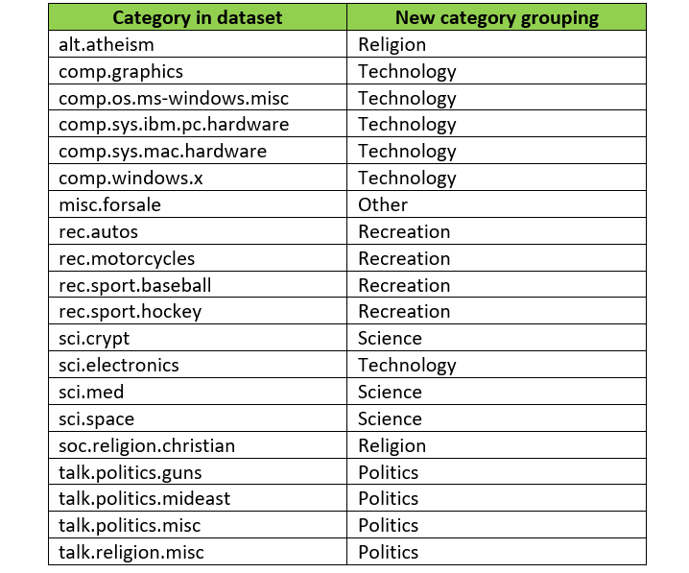
Data Treatment
Vectorize the data to turn the text into numerical values for statistical analysis
Map Target_names from the original 20 categories to the new 6 categories

Slide 5
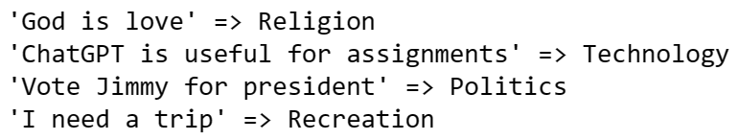
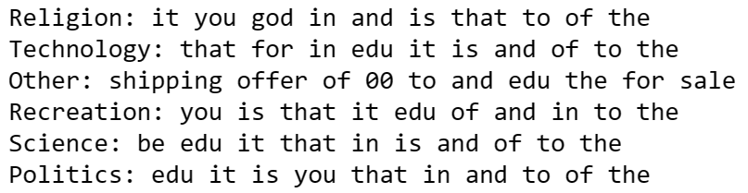
Model Result
F1-score: Harmonic mean of precision % and recall %
Weighted Average F1-Score: 0.905
Sample Text Classifying
Top 10 Informative Features

Slide 6
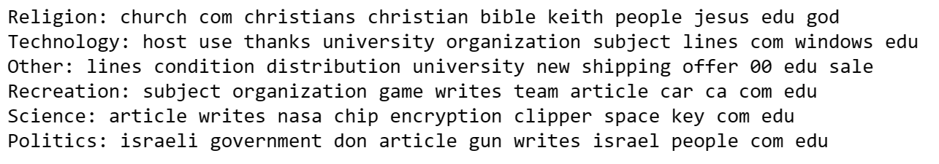
Model Validation and Data Treatment Cont’d
Weighted Average F1-Score: 0.906
Top 10 Features after remove stop_words

Slide 7
Strip Newsgroup Related Metadata by removing Header, Footer, and Quotes
With such an abundance of clues that distinguish newsgroups, the classifiers barely have to identify topics from text at all, and they all perform at the same high level.
The classifier lost over its F1-score and new weighted average F1-Score is 0.816, but the model is more realistic.

Slide 8
Future monitoring and internal data training
High quality data collection and labelling
Continuous monitoring and improvement of the model
Human feedback: gather end user perspective for improvement
Incorporation of domain expertise

Slide 9
Thank you for listening!
Q&A Session

